Slide 1

Sales Performance Dashboard – Superstore
Power BI
Radheya Sachin Deshmukh
Internship Name: Data Analyst Internship – Task 4
Date: 25 April 2025
Tool Used: Power BI Desktop
Dataset: Superstore Dataset (Kaggle)

Slide 2
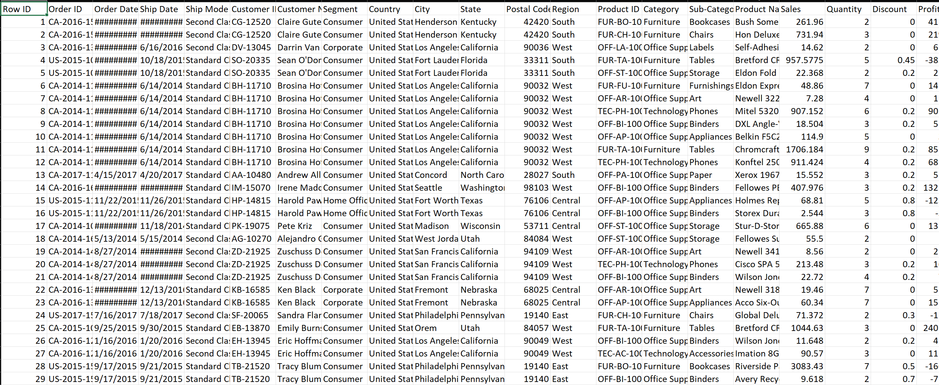
Dataset Description
Name: Superstore Sales Dataset
Source: Kaggle
Records: ~10,000 orders
Fields Used: Order Date, Sales, Profit, Region, Category, Segment, Quantity, Discount
Purpose of Dataset:
Understand sales trends and performance across regions, categories, and customer segments.
Visual:

Slide 3
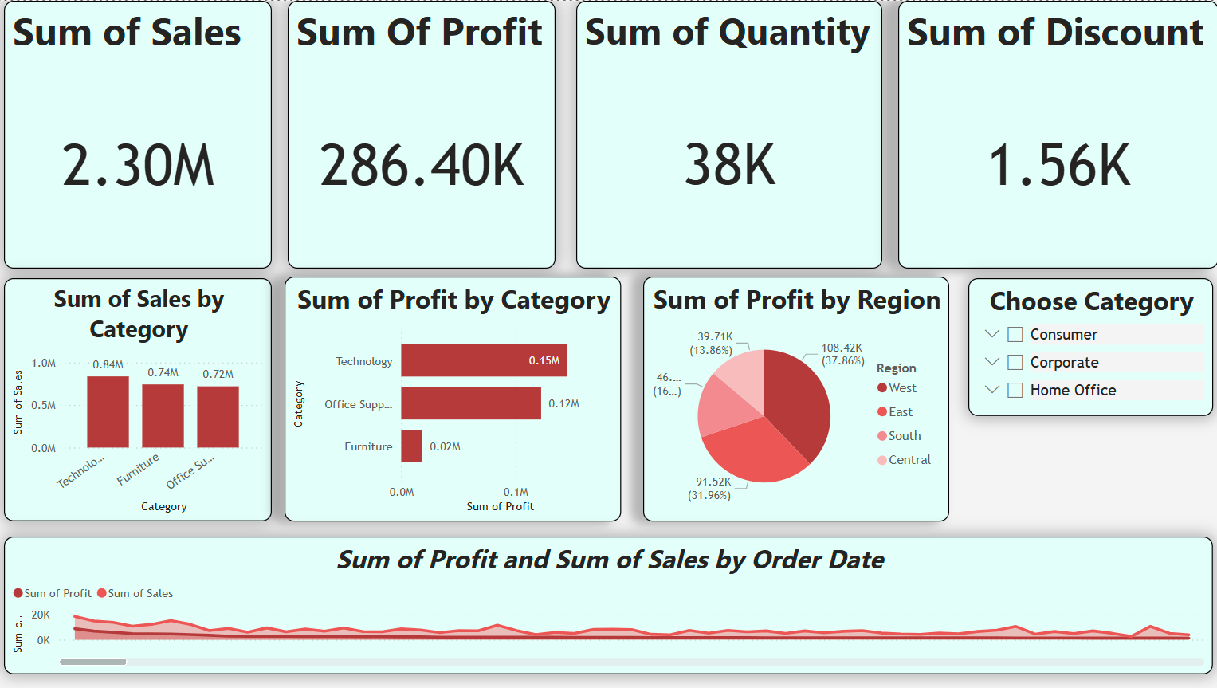
Power BI Dashboard
The dashboard provides a comprehensive overview of key sales metrics using interactive visuals such as cards, charts, and slicers.

Slide 4
Key Metrics & Business Insights
KPIs Used:
Total Sales
Total Profit
Total Quantity
Average Discount
Insights:
🔸 Sales are highest in the West region.
🔸 Technology category generates the most profit.
🔸 Tables in Furniture have high sales but low profit margins.
🔸 Quarter 4 shows the highest sales spike across all years.

Slide 5

What I Learned ?
Hands-on experience with Power BI (data cleaning, modeling, visuals)
Understanding of business KPIs and dashboard design
Learned how to make dashboards interactive using slicers and filters
Gained insight into how data tells a story
This project enhanced my ability to communicate data-driven insights visually and effectively

